Slide 1
ELECTION AUTOMATION ANALYSIS
By Divya Vipparla
Nidheesha Rudraraju
Sri Chetan Vallabhaneni
Nandini Vadlamudi

Slide 2
INTRODUCTION
This project focuses on conducting a comprehensive election audit using Python programming to analyze and visualize election data efficiently. The primary goal is to provide accurate and credible results for a recent local congressional election. The election audit covers various aspects, including total votes, voter turnout for each county, percentage of votes from each county, identification of the county with the highest turnout, and determining the winning candidate along with their vote count and percentage.

Slide 3
DATA SOURCE
The project utilizes a dataset sourced from the Colorado Board of Elections, encapsulated within a CSV file named "election_results.csv.“
This dataset is rich with pertinent information, detailing total votes cast, candidate identities, and county affiliations.
Its comprehensive nature makes it an ideal resource for conducting a meticulous election audit, enabling deep insights into critical aspects such as voter turnout, candidate popularity, and voting patterns across different counties.
The project's primary focus centers on executing a thorough and transparent election audit, where clarity and precision are paramount.
Leveraging Python's robust data analysis and data visualization capabilities, the script navigates through the dataset, extracting invaluable insights while maintaining clarity and conciseness in presenting the results.
The dataset's suitability is a cornerstone of this endeavor, as its contents seamlessly align with the objectives of the election audit.
By dissecting the data, the script facilitates a granular examination of voter behaviors and candidate performances, laying the groundwork for informed decision-making and policy formulation.

Slide 4
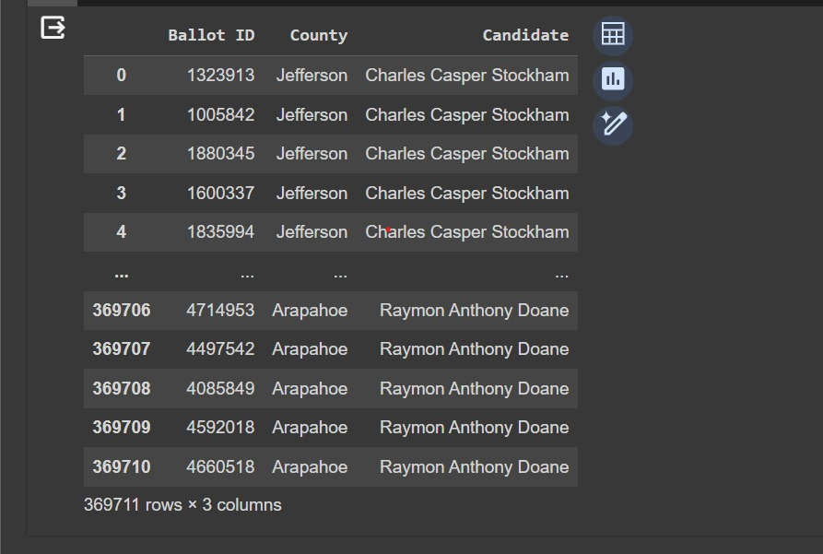
DATA SET

Slide 5
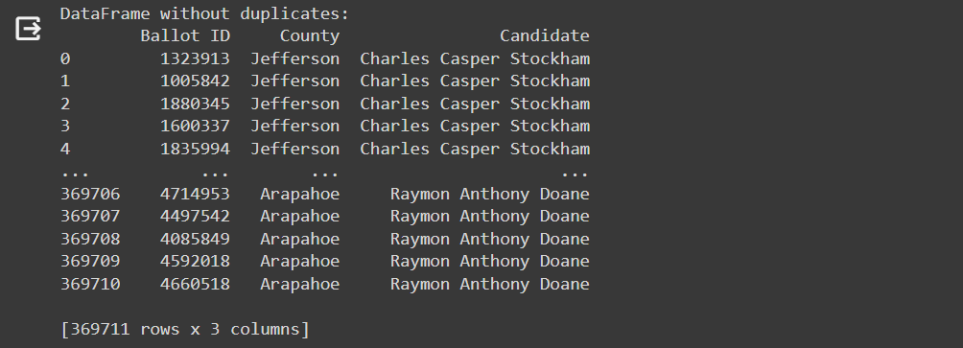
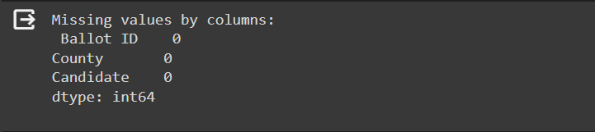
Data Processing
Ensuring clean data is key for reliable analysis. Data cleaning tackles two frequent issues: duplicates (data points appearing multiple times) and missing values (empty data points). Duplicates can be removed entirely or merged if slightly different. Missing values require strategies like deletion (if minimal), imputation (estimating values), or adding a new category (for informative missing reasons).

Slide 6
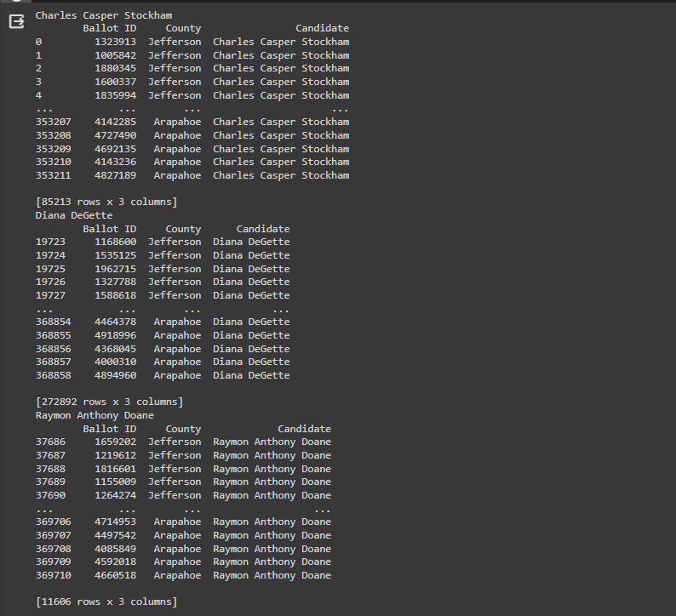
Data grouping by candidate name to organize information based on individual candidates. It essentially sorts data entries where the "candidate name" field acts as the category. This allows you to analyze and compare information specific to each candidate.

Slide 7
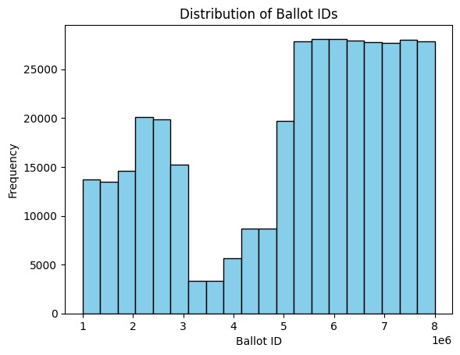
Data Visualization
HISTOGRAM for Ballot Ids
A histogram for Ballot IDs and frequency shows how often each Ballot ID appears in a dataset. It uses bars to represent Ballot ID ranges on the x-axis and the frequency of each range on the y-axis. This visualization helps in understanding the dataset by highlighting common Ballot IDs and any distribution patterns.

Slide 8
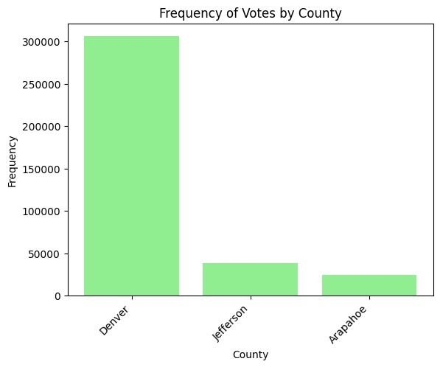
BAR GRAPH for County
A bar graph comparing counties and their frequencies displays how often each county appears in a dataset. Each county is shown as a bar, with the height of the bar indicating its frequency. This graph makes it easy to see which counties are most common and compare their frequencies.

Slide 9
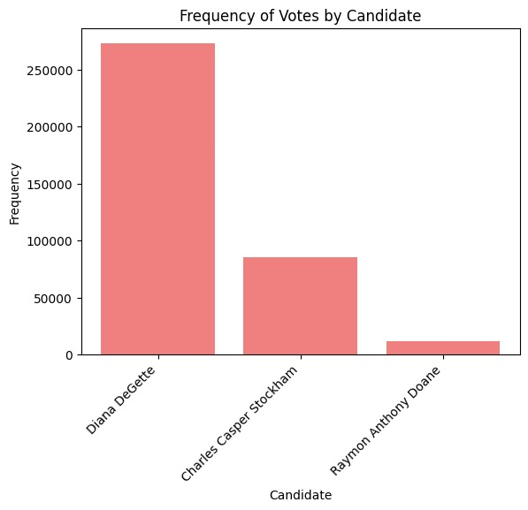
BAR GRAPH for Candidate
The bar graph simply shows how often each candidate appears in the dataset. Each candidate has a bar, and the height of the bar shows their frequency. This makes it easy to see which candidates are most common and compare their frequencies.

Slide 10
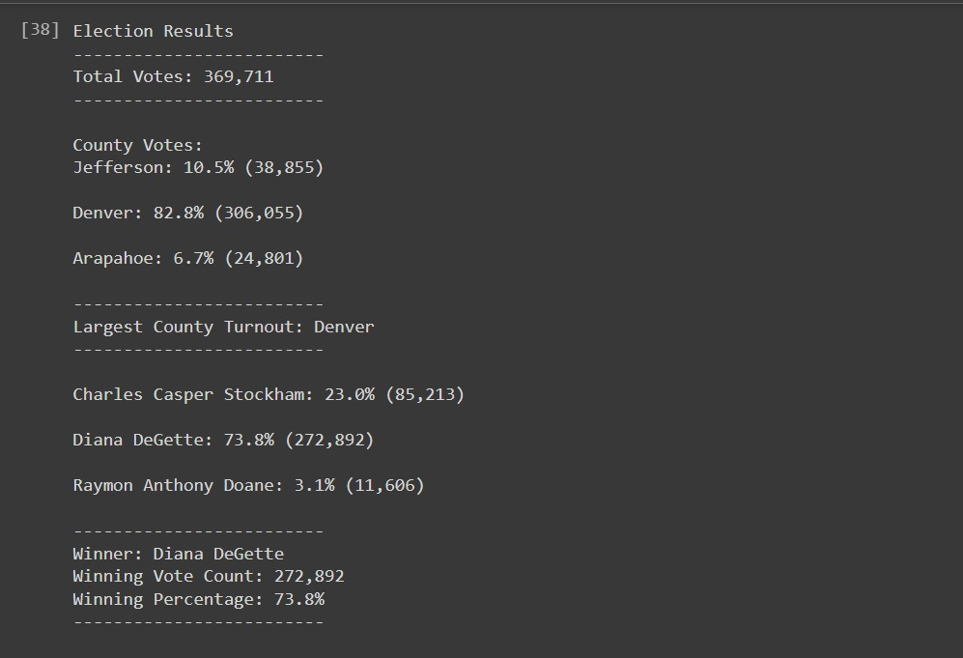
RESULTS & OBSERVATIONS
The Election-Audit Results present a comprehensive overview of the recent election, with a total of 369,711 votes cast. Notably, Denver County exhibited the highest turnout, with 82.8% of the vote and 306,055 ballots counted. Diana DeGette emerged victorious, securing 73.8% of the total vote, amounting to 272,892 votes. The accuracy and credibility of these results are emphasized, inviting validation by the election commission and Colorado Board of Elections through the provided PyPoll_Challenge.py script. This commitment to electoral integrity underscores the transparency and accountability of the electoral process.

Slide 11
Conclusion
In summary, the project's analysis of the recent congressional election provided valuable insights. Through Python programming, it determined total votes, county-wise turnout, identified the county with the highest turnout, and analyzed candidate performance. Denver County had the highest turnout, and Diana DeGette emerged as the clear winner. The proposed modifications to the auditing script aim to improve its usefulness across different elections, enhancing election analysis and auditing methods. This emphasizes the importance of transparent and credible elections. Overall, the findings offer valuable guidance for election commissions and stakeholders committed to fair and accurate electoral processes.

Slide 12
THANK YOU

